Slide 1
Abstract:
With advances in computing and telecommunications technologies, digital images and video are playing key roles in the present information era. Human face is an important biometric object in image and video databases of surveillance systems. Detecting and locating human faces and facial features in an image or image sequence are important tasks in dynamic environments, such as videos, where noise conditions, illuminations, locations of subjects and pose can vary significantly from frame to frame. An automated system for human face recognition in real time background for a college to mark the attendance of their employees and students. So Smart Attendance using Real Time Face Recognition is a real world solution which comes with day to day activities of handling employees. Here multiple user faces are detected and recognized with the data base trained multiple texture based features. These can be in real time from a video camera or from photographs. An example where this technology is used are in airport security systems. In order to recognize a face, the camera software must first detect it and identify the features before making an identification. In this case face recognition needs face detection for making an identification to “recognize” a face. Face detection uses classifiers, which are algorithms that detects what is either a face(1) or not a face(0) in an image. Classifiers have been trained to detect faces using thousands to millions of images in order to get more accuracy. OpenCV uses two types of classifiers, LBP (Local Binary Pattern) and HaarCascades.

Slide 2
INTRODUCTION
As one of the most successful applications of image analysis and understanding, face recognition has recently received significant attention, especially during the past several years. At least two reasons account for this trend:
the first is the wide range of commercial and law enforcement applications,
the second is the availability of feasible technologies after 30 years of research.
Even though current machine recognition systems have reached a certain level of maturity, their success is limited by the conditions imposed by many real applications.
For example, recognition of face images acquired in an outdoor environment with changes in illumination and/or pose remains a largely unsolved problem. In other words, current systems are still far away from the capability of the human perception system.This paper provides an up-to-date critical survey of still- and video-based face recognition research. There are two underlying motivations for us to write this survey paper: the first is to provide an up-to-date review of the existing literature,

Slide 3
the second is to offer some insights into the studies of machine recognition of faces. To provide a comprehensive survey, we not only categorize existing recognition techniques but also present detailed descriptions of representative methods within each category. In addition, relevant topics such as psychophysical studies, system evaluation, and issues of illumination and pose variation are covered..

Slide 4
SURVEY
Rowley et al (1998) have provided a neural network-based upright frontal face detection system in “Neural Network-Based Face Detection”. To collect negative examples, a bootstrap algorithm is used, which adds false detections into the training set, as training progresses.
Jianming Lu et al (2007) have presented a new method of face recognition on fuzzy clustering and parallel neural networks, based on the neuron-fuzzy system. The face patterns are divided into several small-scale 33 parallel neural networks based on fuzzy clustering, and they are combined to obtain the recognition result.
Yu et al (2001) has discussed Multiple Fisher Classifiers Combination for Face Recognition based on Grouping Ada Boost Gabor Features. The key issue in using Gabor features is how to efficiently reduce its high dimensionality. Gabor-based representation is too high dimensional even after being selected by some feature selection methods. In order to increase the total dimension of FDA subspace, the AdaBoosted Gabor features are regrouped into some smaller feature subsets.
Hongzhou Zhang et al (2007) have implemented face recognition by reconstructing frontal view features using linear transformation in “Face Recognition Using Feature Transformation” under different poses. Fei Zuo and Peter (2008) have introduced a fast face detector using an efficient architecture in “Cascaded face detection using neural network ensembles” based on a hierarchical cascade of neural network ensembles with which enhanced detection accuracy and efficiency are achieved.

Slide 5
Dmitry Bryliuk and Valery Starovoitov (2002) in “Access Control by Face Recognition Using Neural Networks” have considered a Multilayer Perceptrons Neural Network (NN) for access control based on face image recognition. The robustness of NN classifiers with respect to the False Acceptance and False Rejection errors is studied. A new thresholding approach for rejection of unauthorized persons is proposed.
Keun-Chang Kwak et al (2007) employed Fisher based Fuzzy Integral and Wavelet Decomposition methods for face recognition in the University of Alberta Shiguang Shan et al (2004) dealt with the Gabor Wavelet for Face Recognition from the angle of its robustness to mis-alignment

Slide 6
WHAT IS COMPUTER VISION
Computer vision is an interdisciplinary scientific field that deals with how computers can be made to gain high-level understanding from digital images or videos. From the perspective of engineering, it seeks to automate tasks that the human visual system can do.
Computer vision tasks include methods for acquiring, processing, analyzing and understanding digital images, and extraction of high-dimensional data from the real world in order to produce numerical or symbolic information, e.g. in the forms of decisions.
Understanding in this context means the transformation of visual images (the input of the retina) into descriptions of the world that can interface with other thought processes and elicit appropriate action. This image understanding can be seen as the disentangling of symbolic information from image data using models constructed with the aid of geometry, physics, statistics, and learning theory.

Slide 7
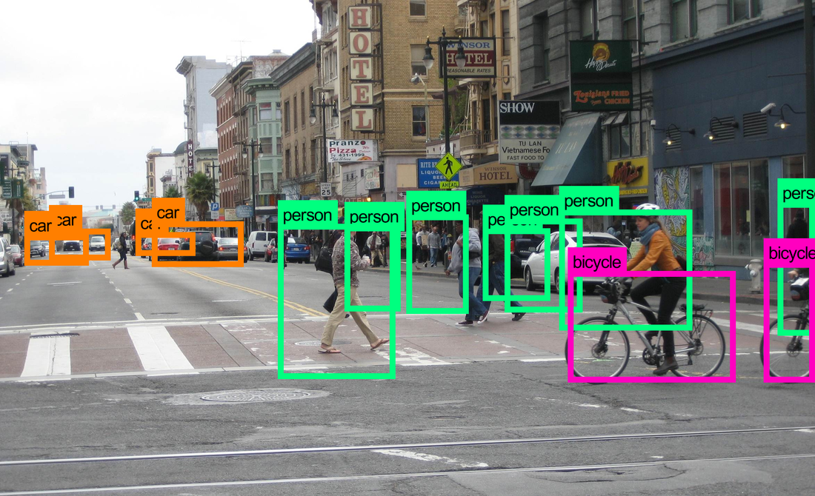
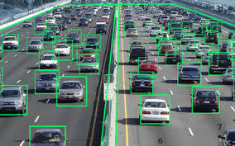

Slide 8
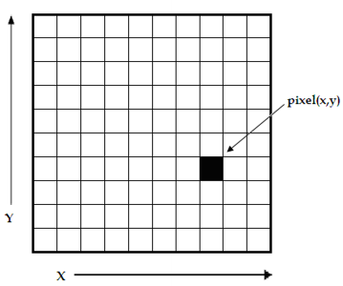
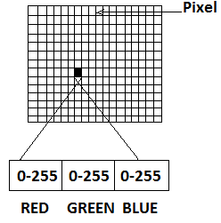
HOW ACOMPUTER READS AN IMAGE:

Slide 9
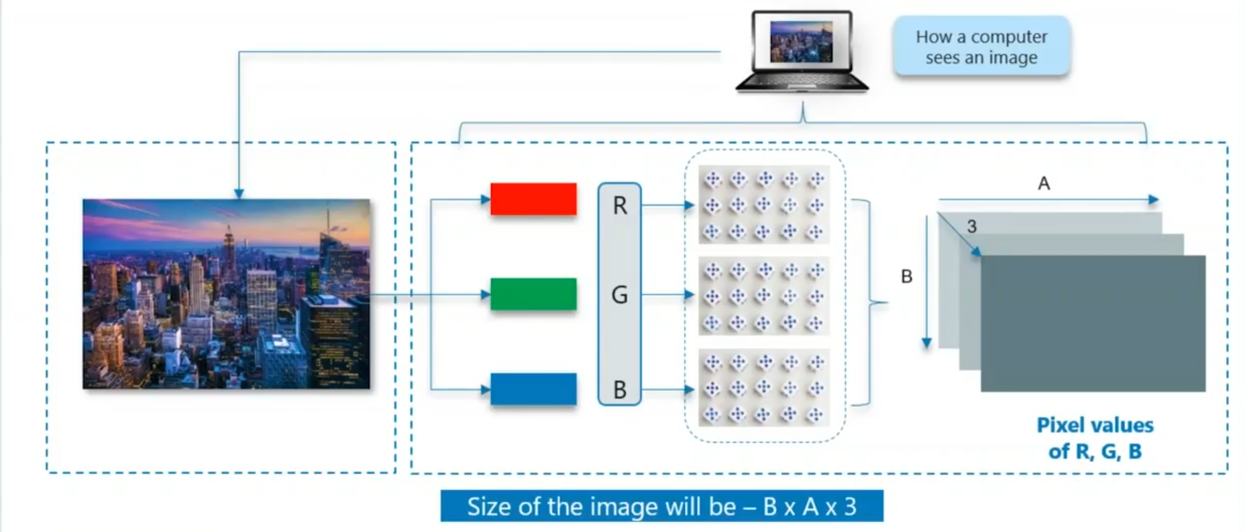

Slide 10
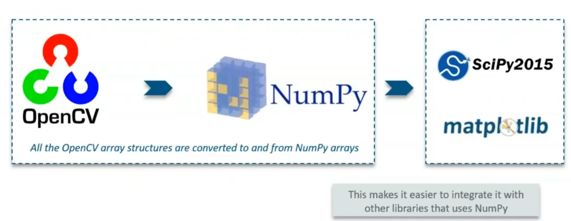
What Is OpenCV
OpenCV (Open Source Computer Vision Library) is an open source computer vision and machine learning software library. OpenCV was built to provide a common infrastructure for computer vision applications and to accelerate the use of machine perception In the commercial products.
OpenCV is a python library designed to solve computer vision problem.

Slide 11
Face Detection using OpenCV
IMAGE
Create a cascade classifier. Which will contain the face feature
Displaying image with rectangular box
OpenCV
NumPy Array

Slide 12
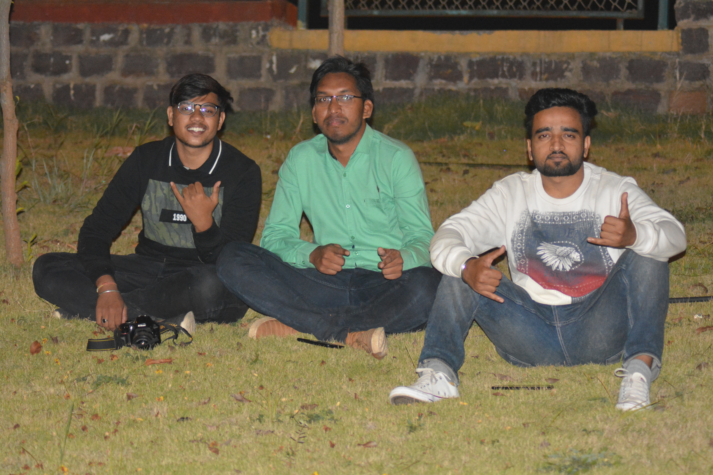
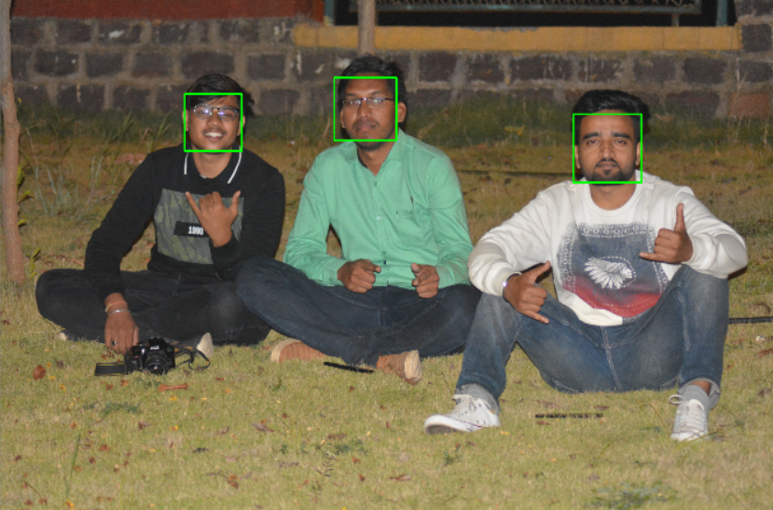
Example:

Slide 13
SCOPE
1.Facial recognition :
Face detection is used in biometrics, often as a part of (or together with) a facial recognition system. It is also used in video surveillance, human computer interface and image database management.
2. Photography :
Some recent digital cameras use face detection for autofocus. Face detection is also useful for selecting regions of interest in photo slideshows that use a pan-and-scale Ken Burns effect.
Modern appliances also use smile detection to take a photograph at an appropriate time.
3. Marketing :
Face detection is gaining the interest of marketers. A webcam can be integrated into a television and detect any face that walks by. The system then calculates the race, gender, and age range of the face. Once the information is collected, a series of advertisements can be played that is specific toward the detected race/gender/age.

Slide 14
4. Emotional Inference :
Face detection can be used as part of a software implementation of emotional inference. Emotional inference can be used to help people with autism under stand the feelings of people around them.
5. Lip Reading :
Face detection is essential for the process of language inference from visual queues. Lip reading has applications in help computers determine who is speaking which is needed when security is important.

Slide 15
CONCLUSION
To improve the recognition performance, there are MANY things that can be improved here, some of them being fairly easy to implement. For example, you could add color processing, edge detection, etc.
You can usually improve the face recognition accuracy by using more input images, at least 50 per person, by taking more photos of each person, particularly from different angles and lighting conditions.
It is important to have a lot of variation of conditions for each person, so that the classifier will be able to recognize the person in different lighting conditions and positions, instead of looking for specific conditions

Slide 16
REFERENCES
[1] Face Detection and Recognition using OpenCV, Article, http://shervinemami.info/faceRecognitio n.html, Published by Shervin Emami, 2010
[2] Seeing with OpenCV, Article, http://www.cognotics.com/opencv/servo _2007_series/part_1/index.html, Published by Robin Hewitt, 2010
[3] OpenCV Homepage, http://opencv.willowgarage.com
[4] Face Recognition Homepage, http://www.face-rec.org/algorithms/
[5] Wikipedia, Three-dimensional face recognition, http://en.wikipedia.org/wiki/Threedimensional_face_recognition
[6] Wikipedia, Active appearance model, http://en.wikipedia.org/wiki/Active_appe arance_model

